Slide 1

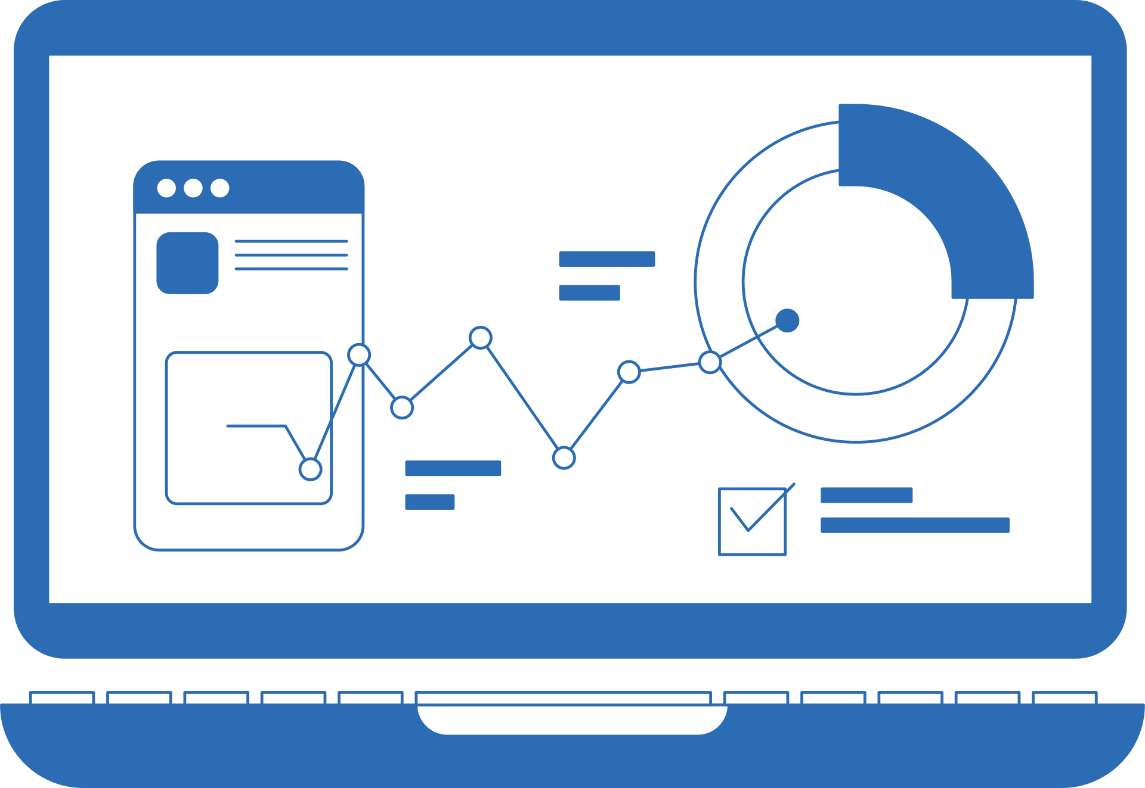

Page 005
Analysis
Data QC
Steps
Data Cleaning
----------------
----------------
-----------------
-----------------

